Slide 1
Introduction to
Intra-EU Investment Protection
The training material was created under the service contract between the European Commission Directorate-General for Financial Stability, Financial Services and Capital Markets Union and the Academy of European Law (contract number FISMA/2022/LVP/0010) and financed by the European Union. This document has been prepared for the European Commission however it reflects the views only of the authors, and the European Commission is not liable for any consequence stemming from the reuse of this publication

Slide 2
Contents of the Course
Introduction
Justified and unjustified restrictions to investments under EU Law
Case Study 1: Freedoms and principles protecting intra-EU investments
Case Study 2: Protection of property against expropriation under the Charter of Fundamental Rights and the European Convention of Human Rights
Procedural rights and effective judicial remedies under EU Law
Remedies for the breach of Investors’ Rights under EU Law

Slide 3
Contents of Introduction
Why are we here?
Aim of the course
Where do we stand?
Achmea and the end of international investment law protection in the context of intra-EU investment
What used to be an investment claim?
A look to the past: International Investment Law
How do claims brought by investors fit the EU legal framework?
Definitions, Contested Measures, Investment Cycle
FISMA/2022/LVP/0010 – Online training material for judges – 1. Introduction to Intra-EU Investment Protection

Slide 4
Introduction to the Course
Aims:
  Ensure that any judge confronted with a claim pertaining to intra-EU investment protection would be able to easily identify the applicable legal framework at Union level, as well as the relevant legal acquis and case law of the Court of Justice.
Guiding questions for the course:
  What is an ‘investment’ claim?
  What is investment protection?
  Why do we need investment protection?
  Which EU legal rules and principles apply?
  How do national judges apply EU legal rules?
  What role for human rights?
  How do claims materialise?
  What recourse do EU investors have?
FISMA/2022/LVP/0010 – Online training material for judges – 1. Introduction to Intra-EU Investment Protection

Slide 5
Historical overview
Investment made by a national of one EU MS in the territory of another, has always enjoyed protection offered to it by EU laws and regulations but investors used to also have access to the protection offered to them by the framework of international investment law (IIL) – and would most often choose to bring their claims in front of investment tribunals rather than involve local courts
IIL protection standards are enshrined in agreements such as bilateral investment treaties (BITs): prior to 2018 there were some 190 BITs concluded between MS (today: zero)
So, why do we need to know a little bit about international investment law?
  Lawyers may bring unfamiliar arguments which will need to be addressed with recourse to EU law
  Language used in investment claims can be very similar to that of EU law but have different connotations (e.g. legitimate expectations) – need to make sure that the parties are using the correct terms
  Investors may believe they are entitled to big sums of money for compensation
FISMA/2022/LVP/0010 – Online training material for judges – 1. Introduction to Intra-EU Investment Protection

Slide 6

Substantive standards under International Investment Law
Expropriation
Fair and Equitable Treatment
Non-discrimination (National Treatment and Most-Favoured-Nation Treatment)
Full Protection and Security
In the EU context: historically, the two most often invoked: expropriation and FET
FISMA/2022/LVP/0010 – Online training material for judges – 1. Introduction to Intra-EU Investment Protection

Slide 7
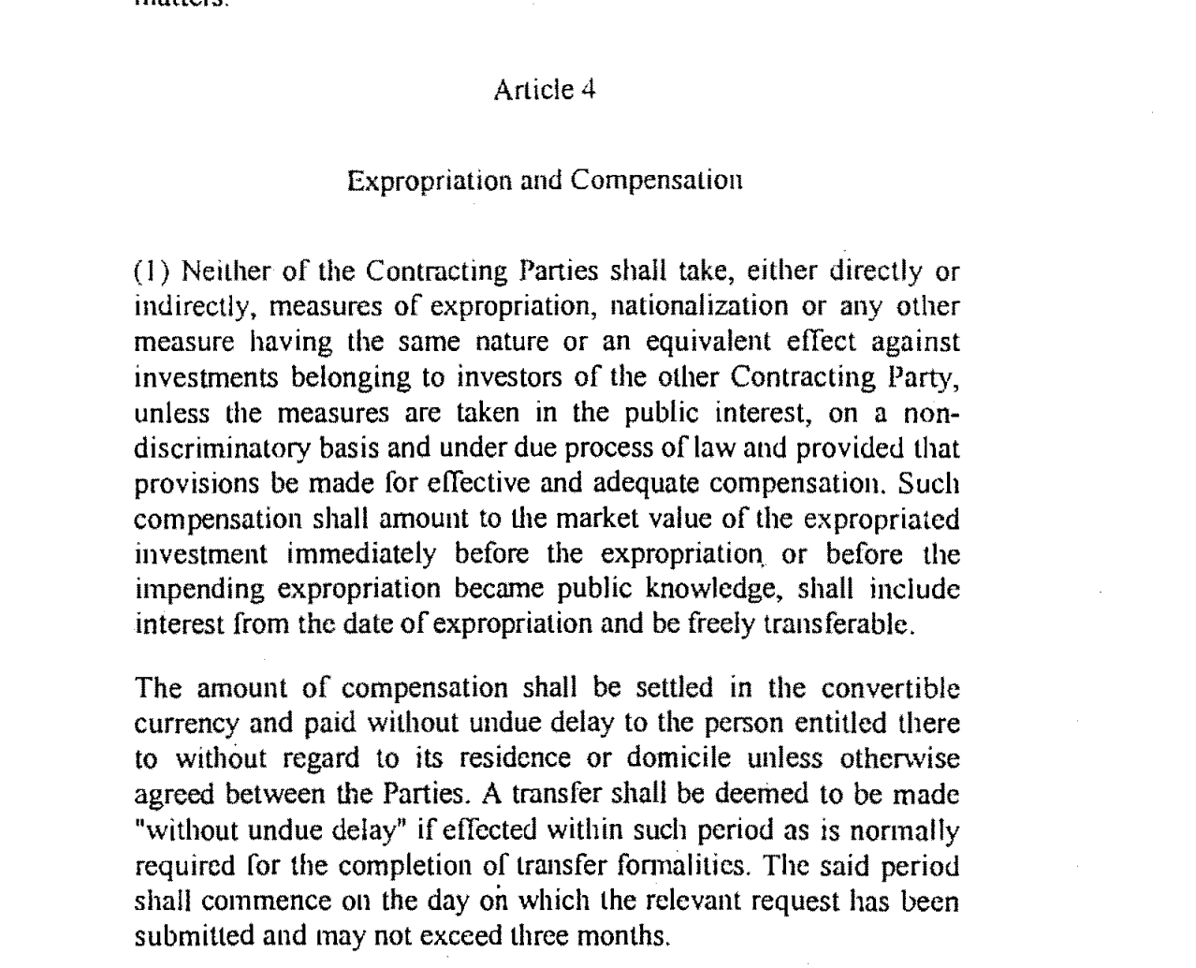
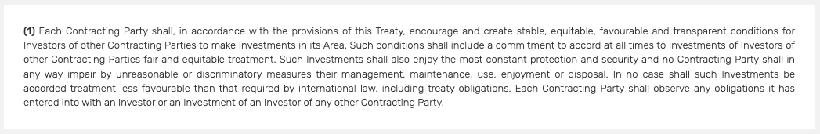
Example of Substantive Standards
Example of Expropriation clause
(Poland-Lithuania BIT):
Example of an FET clause (ECT):
FISMA/2022/LVP/0010 – Online training material for judges – 1. Introduction to Intra-EU Investment Protection

Slide 8
Example of an intra-EU claim
Antin v. Spain
Facts: In 2007, Spain passed legislation that created favourable conditions for investing in its renewable energy sector. By the end of 2013, Spain had an estimated accumulated tariff deficit (the financial gap between the subsidies paid to energy producers and revenues derived from energy sales to consumers) of some €30 billion, which threatened the sustainability of Spain’s electricity system. After some back and forth, Spain abolished the regime altogether and replaced it with a new one by June 2014.
Investors claimed Spain breached their legitimate expectations (as part of FET), since Spain “represented, through its acts and regulations, that the economic regime applicable to RE projects would remain stable and predictable”.
Tribunal awarded investors €112 million (out of about €200 million claimed)
FISMA/2022/LVP/0010 – Online training material for judges – 1. Introduction to Intra-EU Investment Protection

Slide 9

Intra-EU claims in numbers
By 31 July 2018, some 91 intra-EU ISDS cases had been concluded and 83 were pending. About 45% of all concluded cases were decided in favour of the State, and about 25% were decided in favour of the investor, with monetary compensation awarded.
On average, successful claimants in intra-EU disputes were awarded about 45% of the amounts they claimed. In cases decided in favour of the investor, the average amount claimed was €203 million and the median €88 million. The average amount awarded was €91 million and the median €30 million (July 2018 stats)
FISMA/2022/LVP/0010 – Online training material for judges – 1. Introduction to Intra-EU Investment Protection

Slide 10
CJEU’s decisions in Achmea & co.
End of intra-EU ISDS
Slovak Republic v. Achmea
6 March 2018
ISDS clauses in BITs are incompatible with EU Law – Arts 267 and 344 TFEU
Rise of "Achmea" objections to jurisdiction/annulment in ISDS and rise of other objections to enforcement in 3rd States national courts = both largely unsuccessful
Declaration of the Member States on the legal consequences of the Achmea judgment and on investment Protection.
15 January 2019
Agreement for the Termination of BITs between the Member States of the EU
5 May 2020
MS agreed to terminated some 190 BITs
Subsequent EU Case Law developments
Moldova v. Komstroy decision obiter dicta – ISDS clauses in Energy Charter Treaty, in an intra-EU setting, are incompatible with EU Law
2 September 2021
Poland v. PL Holdings decision (EU law precluded States from concluding ad hoc arbitration agreements the contents of which are identical to intra-EU BITs
26 October 2021
Romania v. Micula decision (on enforcement of awards and state aid, and on consent to arbitrate post-EU accession)
25 January 2022 & 21 September 2022
FISMA/2022/LVP/0010 – Online training material for judges – 1. Introduction to Intra-EU Investment Protection
10

Slide 11
Now: EU to fill in the gaps with its laws, regulations, principles and human rights
FISMA/2022/LVP/0010 – Online training material for judges – 1. Introduction to Intra-EU Investment Protection

Slide 12
Who is an investor?
What is an investment?
Under IIL: tests and definitions contained in case law and international investment agreements
Under EU law: no rules on ‘investor’ but many rules on rights of natural and legal persons, plus concept of property under the Charter and human rights law
FISMA/2022/LVP/0010 – Online training material for judges – 1. Introduction to Intra-EU Investment Protection

Slide 13
Examples of measures challenged in intra-EU ISDS – what would they look like under EU law?
Improper conduct of bankruptcy proceedings by host State
Termination of contract with the investor / Cancellation of a license to operate
Irregularities connected to the procedure and outcome of public tenders
Annulment of privatization tender results
Failure to conclude a contract with the winning
Failure to issue a permit / Refusal to allow a transfer of a license to another entity
Unjustified inspections
Causing administrative difficulties in securing land rights / Restricting shareholder rights and requiring the claimant to sell its shares
Withdrawal of prior commitments regarding investment incentives
Failure of the police forces to protect the investor’s business from attacks by third parties
Alleged wrongful enforcement of obligations to pay taxes or other payments
FISMA/2022/LVP/0010 – Online training material for judges – 1. Introduction to Intra-EU Investment Protection

Slide 14
Investment Cycle
Pre-investment stage: access to the market
Examples: participation in public tenders, obtaining approvals for the project
Development Stage
Operational Stage
Exit or dissolution
Example:
Constructing a facility, control and maintaining of facilities
Example:
Producing goods, providing services, employment of staff
Example:
Bankruptcy, sale of assets
FISMA/2022/LVP/0010 – Online training material for judges – 1. Introduction to Intra-EU Investment Protection

Slide 15
Examples of cases in front of CJEU
Commission v. Hungary (Usufruct Over Agricultural Land) – one of the Hungarian usufruct cases based on a Hungarian legislation which provided that rights to usufruct may be granted or maintained only in favour of persons having a close family tie with the owner of the agricultural land concerned. The Court held that cancellation of usufructuary rights constituted a deprivation of property within the meaning of Article 17 CFREU. And, as the deprivation was not justified on the ground of public interest; nor were there any arrangements in place whereby fair compensation would have been paid in good time, the Court found breach of the provision.
Anie and others v. Italy – one of the Italian solar cases based on a change to the State’s feed-in-tariffs system from which investors in solar power were previously benefitting. CJEU sided with Italy, holding that EU laws and principles (legal certainty and legitimate expectations) do not prohibit such changes. In contrast, in some of ISDS tribunals are siding with investors
FISMA/2022/LVP/0010 – Online training material for judges – 1. Introduction to Intra-EU Investment Protection

Slide 16

Content of these slides were created by Prof Peter-Tobias Stoll
Further training material available at: https://elearning-fisma.era.int/
www.european.law

